Slide 1
Instead of becoming psychotic I chose to be a psychiatrist.
One has a better position;
one can watch what is is going on in a family from the outside and take a strategic position
No, I’m not traumatised, stating this would be an insult to my clients

Slide 2
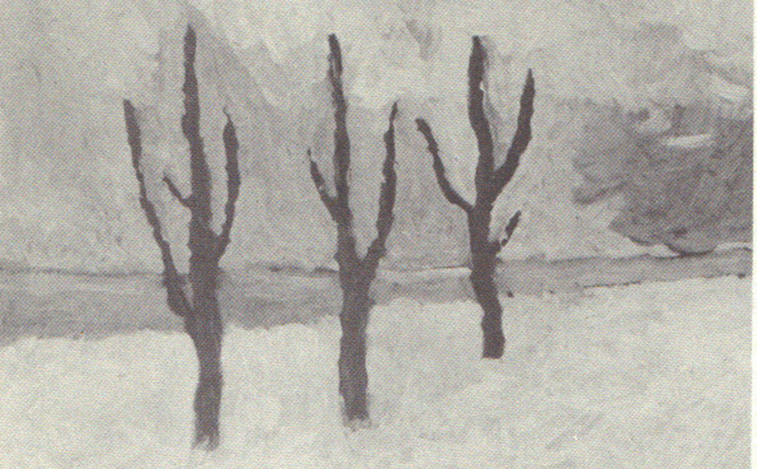
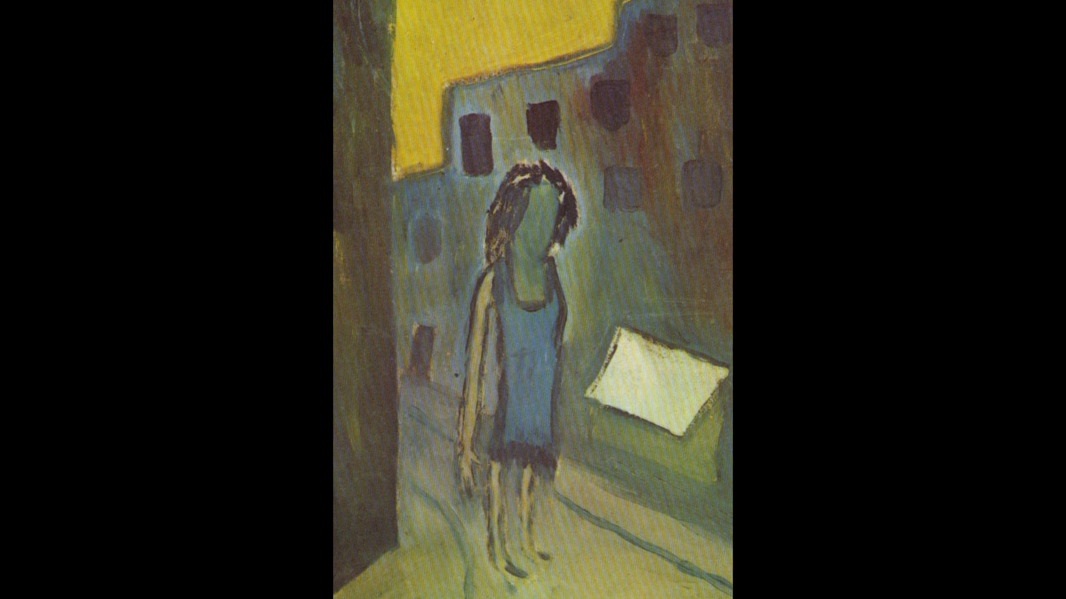
When I was 16 my father worked in a psychiatric hospital.
We had a book at home with pictures patients made
on art therapy, which made a deep impression on me,
the book was full of pictures like these

Slide 3
I asked: Dad, do I have schizophrenia? Nah, he said, you are quite normal Margreet
But I was quite lonely especially when I was a child

Slide 4
Later research revealed that loneliness is a risk factor in developing psychosis (Veling, Jean-Paul Selten)
See book on 2019 conference when it is published

Slide 5
My parents didn’t feel at home in the village where my father was a clergyman
People in the village didn’t read books
At least they didn’t talk about it
My schoolmates called me nuver (weird)
A guy sitting next to me was quite intelligent
But his dad forbid him to go to secondary education

Slide 6
My mom felt unhappy But she never talked about it. She didn’t talk about her feelings at all, except when she was very angry, which was scary
Why is clear communication so important in development?
I wrote a book about this, not accepted by Routledge
(I identify with Friedrich Nietzsche)

Slide 7
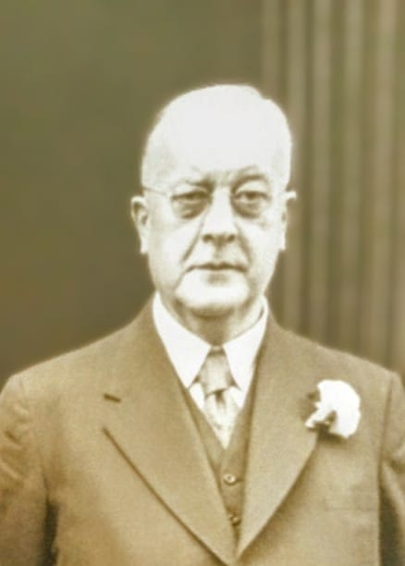
Mom’s dad He was always in his study. Tobacco behind his books in case there would be another war. He was very authorative

Slide 8
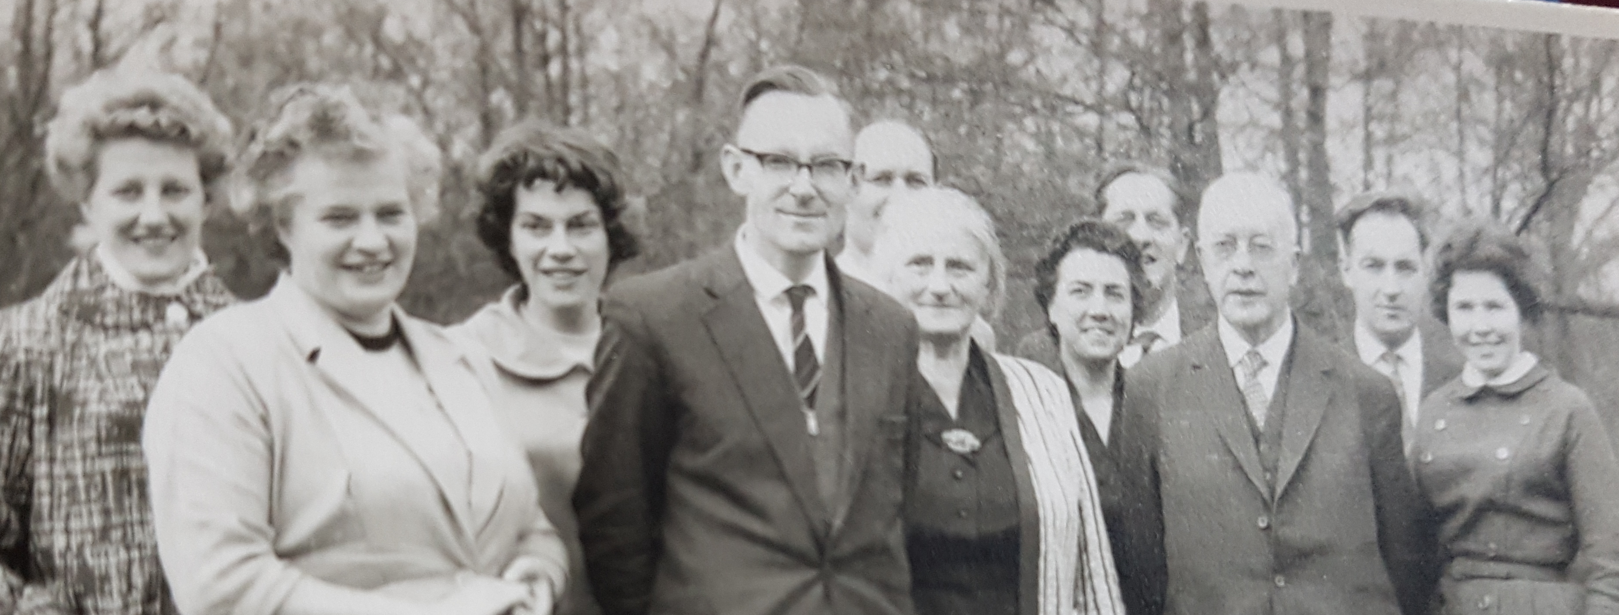
My father and mother with mom’s family

Slide 9
Fotos of my father's family are not in my possession. But this story was told many times: His dad worked as a missionary in Indonesia. His wife became ill and died. There was no support at all from his church. This was experienced as a betrayal

Slide 10
So, my father grew up without his mom (dad was in Indonesia) with an aunt and uncle and was very unhappy I have never understood why he decided to be a clergyman, with this family story. Why serve an institution which betrayed your family.

Slide 11
The church of my father’s dad was very orthodox My dad developed an interpretation of religion where love thy neighbors was the. most important commandment

Slide 12
So, my mom and dad were raised in a very authoritarian manner They decided to be very tolerant in raising their own children

Slide 13
I misbehaved especially to my brother and sister on whom I was jealous I misbehaved and felt very guilty about this.

Slide 14
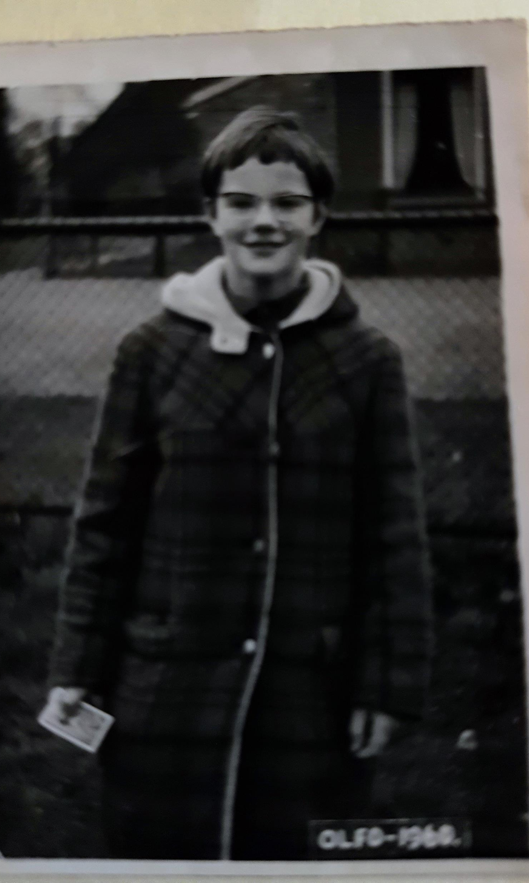
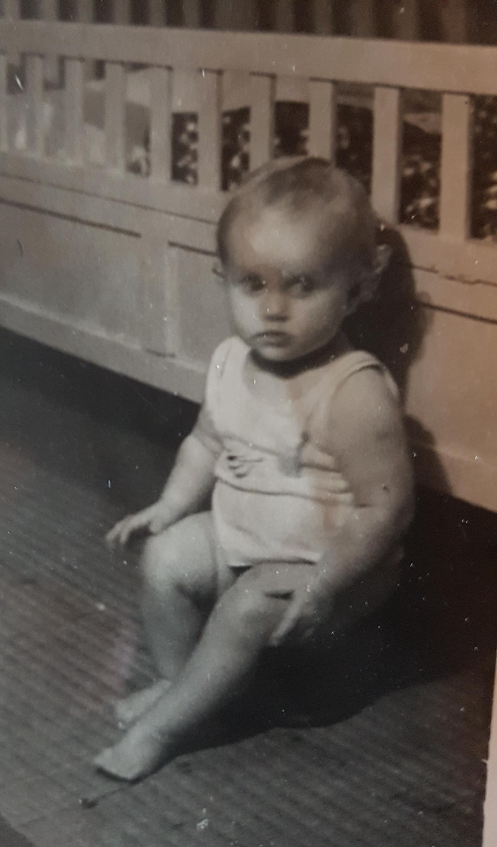
So sometimes I misbehaved, and this was tolerated until my mom exploded, which was scaring I was convinced that I would always hurt my brother and sister so I isolated myself

Slide 15
Maybe that’s why these pictures made such an impression on me

Slide 16
In family work I promoted clear communication and limit setting in accordance with family practice in the seventies Jay Haley, forgotten by ISPS

Slide 17
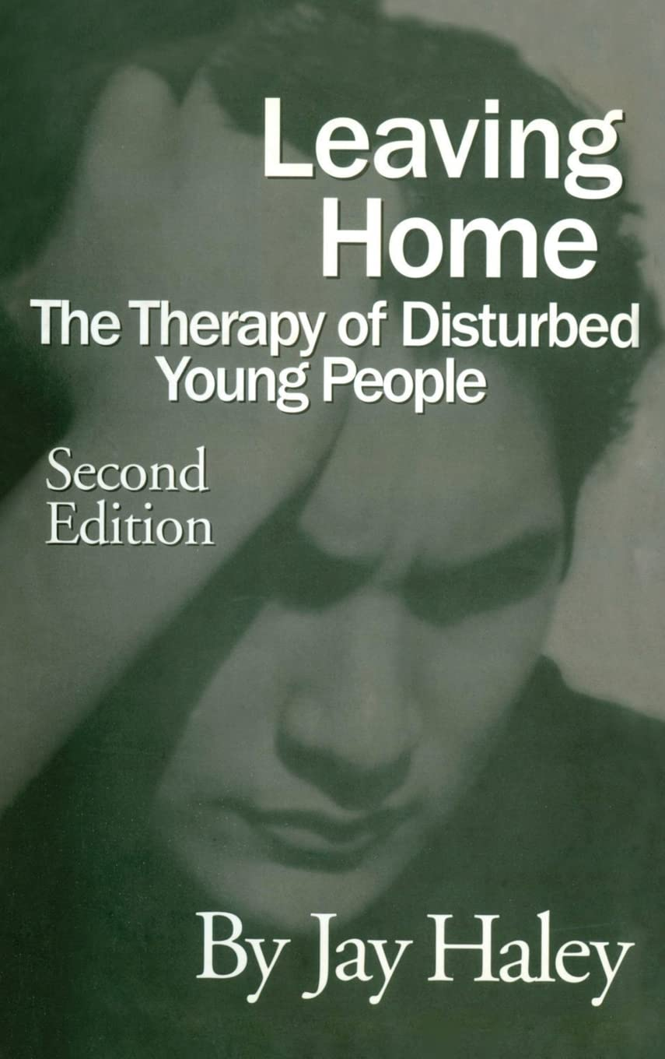
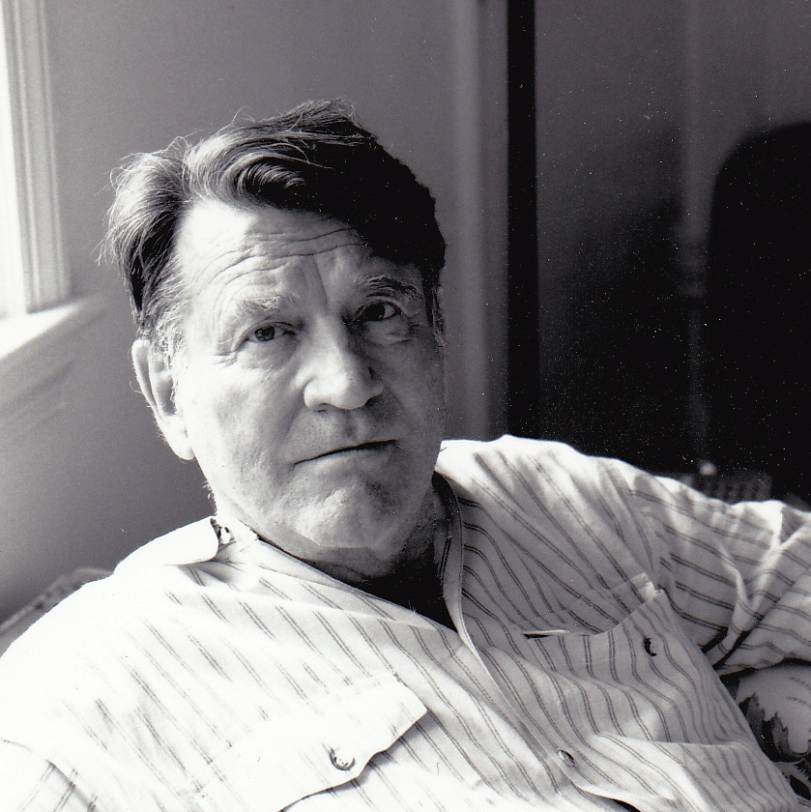
His theory is forgotten, without a good reason

Slide 18
Luckily, my own therapist knew what I needed. I consulted him on a moment when I had the idea that I trespassed my teachers. He stated Margreet you are so aggressive. And then he confronted me

Slide 19
I didn’t sleep the next week. The cat was my only consolation But in the next session I could find polite words to criticize him and felt safe and protected.

Slide 20
Years later I met him and told what new care we had developed in Utrecht Ah he said: told you so Margreet

Slide 21
The method is called family psychoeducation and is well researched but not used in ISPS.
Don’t know if open dialogue has common
characteristics with Family Psychoeducation
I mean in practise not theory
Would be interesting research

Slide 22
The loneliness of psychosis
The role of safe conflicts in prevention and recovery from psychosis

